Slide 1
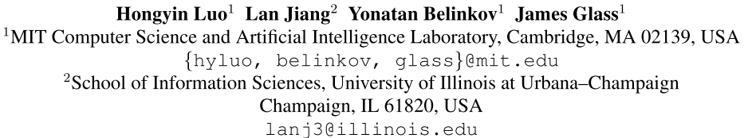
Improving Neural Language Models by Segmenting, Attending, and Predicting the Future
Liu Fang
2019-07-10
Notes:
learning to align the given context and the following phrase

Slide 2
Introduction
Neural language models are typically trained by predicting the next word given a past context.
However, natural sentences are not constructed as simple linear word sequences, as they usually contain complex syntactic information.
A subsequence of words can constitute a phrase, and two non-neighboring words can depend on each other.
Most recent work on neural language modeling learns a model by encoding contexts and matching the context embeddings to the embedding of the next word.

Slide 3
Introduction
We argue that natural sentences are generated at a higher level before being decoded to words. Hence a language model should be able to predict the following sequence of words given a context.
We propose a phrase prediction model that improves the performance of state-of-the-art word-level language models.
Our model learns to predict approximate phrases without any annotation.

Slide 4
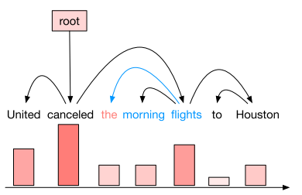
Syntactic Height and Phrase Induction
In this work, we propose a language model that not only predicts the next word of a given context, but also attempts to match the embedding of the next phrase.
Conducting phrase induction based on syntactic heights
Syntactic Heights
Intuitively, the syntactic height of a word aims to capture its distance to the root node in a dependency tree.
A word has high syntactic height if it has low distance to the root node.

Slide 5
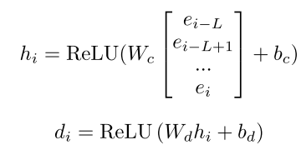
Syntactic Height and Phrase Induction
Syntactic Distance (Shen et al.)
It is proposed for constructing constituent parsing trees. We apply the method for calculating syntactic distance to calculate syntactic height.
It’s possible to identify the beginning and ending words of a constituent using local information.
Formally, the syntactic distance $d_{i}$ is computed with a
temporal convolutional network (TCN)：
Neural Language Modeling by Jointly Learning Syntax and Lexicon (ICLR-2018)
An Empirical Evaluation of Generic Convolutional and Recurrent Networks for Sequence Modeling
Notes:
basic hypothesis is that words in the same constituent should have a closer syntactic relation within themselves, and that this syntactical proximity can be represented by a scalar value.
TCN: 一维卷积变形之后在时序问题上变得适用

Slide 6
Temporal Convolutional Network
Recurrent networks are dedicated sequence models that maintain a vector of hidden activations that are propagated through time.
While there have been multiple thorough evaluations of RNN architectures on representative sequence modeling tasks, we are not aware of a similarly thorough comparison of convolutional and recurrent approaches to sequence modeling.
Propose a generic architecture for convolutional sequence prediction. Our aim is to distill the best practices in convolutional network design into a simple architecture that can serve as a convenient but powerful starting point.
An Empirical Evaluation of Generic Convolutional and Recurrent Networks for Sequence Modeling
Notes:
Our architecture is informed by recent convolutional architectures for sequential data, but is distinct from all of them and was designed from first principles to combine simplicity, autoregressive prediction, and very long memory

Slide 7

Temporal Convolutional Network
Sequence Modeling
$$x_{1},…, x_{T+1}$$
Given an input sequence $x_{0},…, x_{T}$, and wish to predict some corresponding outputs $y_{0},…, y_{T}$at each time.
The key constraint is that to predict the output $y_{t}$ for some time t, we are constrained to only use those inputs that have been previously observed.
Causal Convolutions
TCN is based upon two principles:
the fact that the network produces an output of the same length as the input
the fact that there can be no leakage from the future into the past
Causal convolutions, convolutions where an output at time t is convolved only with elements from time t and earlier in the previous layer.

Slide 8
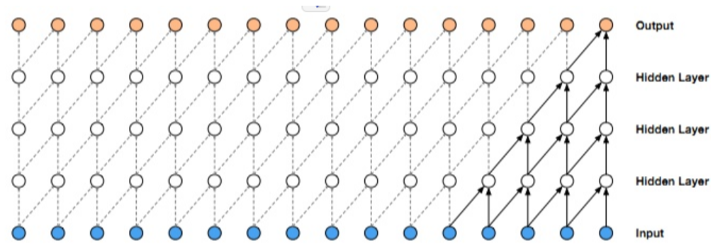
Temporal Convolutional Network
Causal Convolutions
Disadvantage：
In order to achieve a long effective history size, we need an extremely deep network or very large filters, neither of which were particularly feasible when the methods were first introduced

Slide 9

Temporal Convolutional Network
Dilated Convolutions
A simple causal convolution is only able to look back at a history with size linear in the depth of the network
Employ dilated convolutions that enable an exponentially large receptive field
the dilated convolution operation F on element s of the sequence is defined as:
where d is the dilation factor, k is the filter size, and s−d · i accounts for the direction of the past.

Slide 10
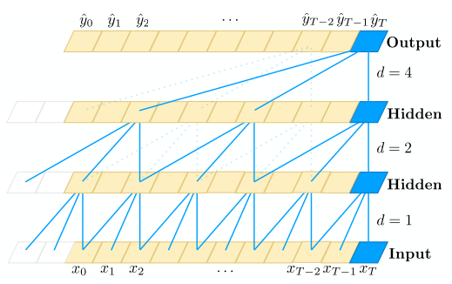
Temporal Convolutional Network
Dilated Convolutions
This gives us two ways to increase the receptive field of the TCN: choosing larger filter sizes k and increasing the dilation factor d, where the effective history of one such layer is (k − 1)d
When using dilated convolutions, we increase d exponentially with the depth of the network (i.e., $d=O(2^{ⅈ})$ at level i of the network)

Slide 11
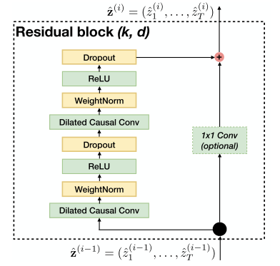
Temporal Convolutional Network
Residual Connections
Since a TCN’s receptive field depends on the network depth n as well as filter size k and dilation factor d, stabilization of deeper and larger TCNs becomes important.
We employ a generic residual module in place of a convolutional layer.
Notes:
in TCN (and ConvNets in general) the input and output could have differ- ent widths. To account for discrepant input-output widths, we use an additional 1x1 convolution to ensure that element- wise addition ⊕ receives tensors of the same shape

Slide 12
Syntactic Height and Phrase Induction
Syntactic distance (Shen et al.)
It’s possible to identify the beginning and ending words of a constituent using local information.
Formally, the syntactic distance $d_{i}$ is computed by:
We apply the method for calculating syntactic distance to calculate syntactic height
Neural Language Modeling by Jointly Learning Syntax and Lexicon (ICLR-2018)

Slide 13

Syntactic Height and Phrase Induction
Syntactic Height
where $h_{i}$ stands for the syntactic height of word $x_{i}$
These heights are learned and not imposed by external syntactic supervision.
We use the syntactic heights to predict induced phrases and calculate their embeddings.

Slide 14
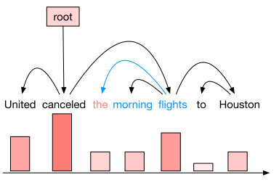
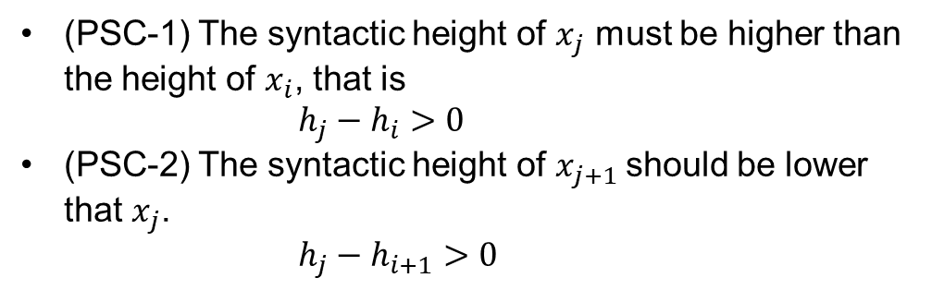
Syntactic Height and Phrase Induction
Phrase Induction
We define the phrase induced by a word based on the syntactic heights.
Consider two words $x_{i}$ and $x_{k},$ $x_{k}$ belongs to the phrase induced by $x_{i}$ if and only if for any $j∈\left(i,k\right)$, $h_{j}<max⁡(h_{i}, h_{k})$
We propose phrase segmenting conditions (PSCs) to find the last word of an induced phrase.
Considering the induced phrase of the i-th word, $s_{i}=\left[x_{i},x_{i+1},…,x_{j}\right]$. There are two conditions that $x_{j}$should satisfy:
(PSC-1) The syntactic height of $x_{j}$ must be higher than the height of $x_{i}$, that is
$h_{j}−h_{i}>0$
(PSC-2) The syntactic height of $x_{j+1}$should be lower that $x_{j}$.
$h_{j}−h_{i+1}>0$
Notes:
K和i之间的word的h小于二者之间的最大值
this definition of an induced phrase does not necessarily correspond to a phrase in the syntactic constituency sense

Slide 15
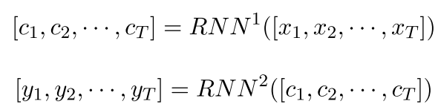
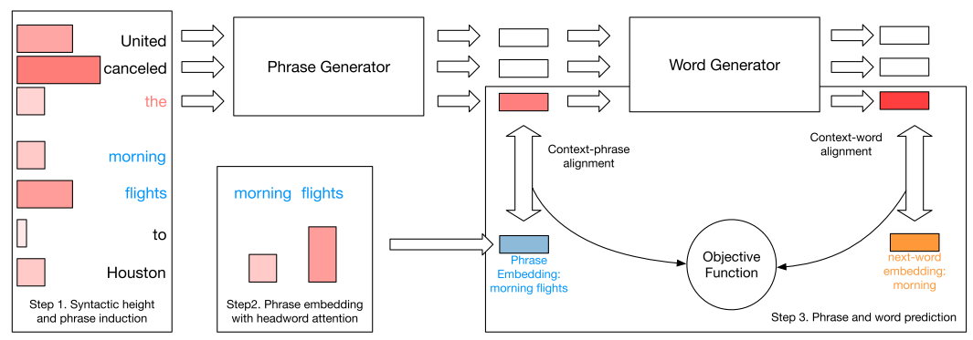
Model
Formulate multi-layer neural language models as a two-part framework. For example, in a two-layer LSTM language model, we use the first layer as phrase generator and the last layer as a word generator:
where $c_{i}$ is the context embedding for phrase prediction, $y_{i}$ is the word vector.

Slide 16


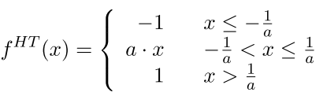



Model
Phrase Segmentation
Calculate the syntactic height and predict the induced phrase for each word:
$$h_{i}=TCN([x_{i−n},x_{i−n+1},…,x_{i}])$$
Based on the proposed phrase segmenting conditions (PSCs), we predict the probability of a word being the first word outside a induced phrase.
Firstly, we decide if each word, $x_{j−1}∈(i+1, n]$, satisfies the two phrase segmenting conditions, PSC-1 and PSC-2
The probability that $x_{j}$ satisfies PSC-1 is
The probability that $x_{j}$ satisfies PSC-2 is
where $f^{HT}$stands for the HardTanh function with a temperature a.
Notes:
p越小，证明该词在phrase中，如果都大则证明是phrase之外词

Slide 17


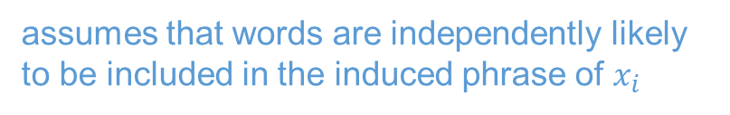
Model
Phrase Segmentation
Then we can infer the probability of whether a word belongs to the induced phrase of $x_{i}$ with:
assumes that words are independently likely to be included in the induced phrase of $x_{i}$
where $p^{ind}\left(x_{i}\right)$ stands for the probability that $x_{i}$ belongs to the induced phrase, and
Notes:
P(psc)越小，证明该词在phrase中，如果都大则证明是phrase中的最后一个词

Slide 18
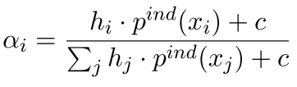


Model
Phrase Embedding with Attention
Given induced phrases, we can calculate their embeddings based on syntactic heights.
To calculate the embedding of phrase $s=\left[x_{1},x_{2},…,x_{n}\right]$ we calculate an attention distribution over the phrase:
where $h_{i}$stands for the syntactic height for word $x_{i}$and $c$ is a constant real number for smoothing the attention distribution.
Then we generate the phrase embedding with a linear transformation:
where $e_{i}$is the word embedding of $x_{i}$
Notes:
对于每个xi, 得到的phrase s=[…]
根据syntax height和在phrase中的概率p算权重

Slide 19
Model
Phrase and Word Prediction
The state-of-the-art neural language models contain multiple layers. The outputs of different hidden layers capture different level of semantics of the context.
We force one of the hidden layers to align its output with the embeddings of induced phrases $s_{i}$.

Slide 20


Model
Phrase and Word Prediction
We use an extra objective function and the negative sampling strategy to align context representations and the embeddings of induced phrases.
Given the context embedding$c_{i}$, the induced phrase embedding $s_{i}$, and random sampled negative phrase embeddings $s_{i}^{neg}$, we train the neural network to maximize the likelihood of true induced phrases and minimize the likelihood of negative samples.
Objective function for context i:
This loss function is used as a regularization term with a coefficient γ:
Notes:
n stands for the number of negative samples
With this loss function, the model learns to maximize the similarity between the context and true induced phrase embeddings, and minimize the similarity between the context and negative samples randomly selected from the induced phrases of other words.

Slide 21
Experiments
Tasks:
word-level language modeling tasks
Datasets:
Penn Treebank, Wikitext-2, and Wikitext-103 corpora
The PTB dataset has a vocabulary size of 10,000 unique words. The entire corpus includes roughly 40,000 sentences in the training set, and more than 3,000 sentences in both valid and test set.
The WT2 data is about two times larger than PTB dataset. The dataset consists of Wikipedia articles. The corpus includes 30,000 unique words in its vocabulary and is not cleaned as heavily as the PTB corpus.
The WT103 corpus contains a larger vocabulary and more articles than WT2. It consists of 28k articles and more than 100M words in the training set.
In each corpus, we apply our approach to publicly-available, state-of-the-art models. This demonstrates that our approach can improve different existing architectures.

Slide 22
Experiments
Penn Treebank
3-layer AWD-LSTM language model
Hidden size: 1150
word embeddings size: 400
apply variational dropout for hidden states and the dropout rate is 0.25
weight dropout: 0.5
apply stochastic gradient descent (SGD) and averaged SGD
learning rate: 30
clip the gradients with a norm of 0.25
randomly sample 1 negative sample for each context
the context-phrase alignment loss is given a coefficient of 0.5
The output of the second layer of the neural network is used for learning context-phrase alignment, and the final layer is used for word generation
Baseline: LSTM-AWD

Slide 23
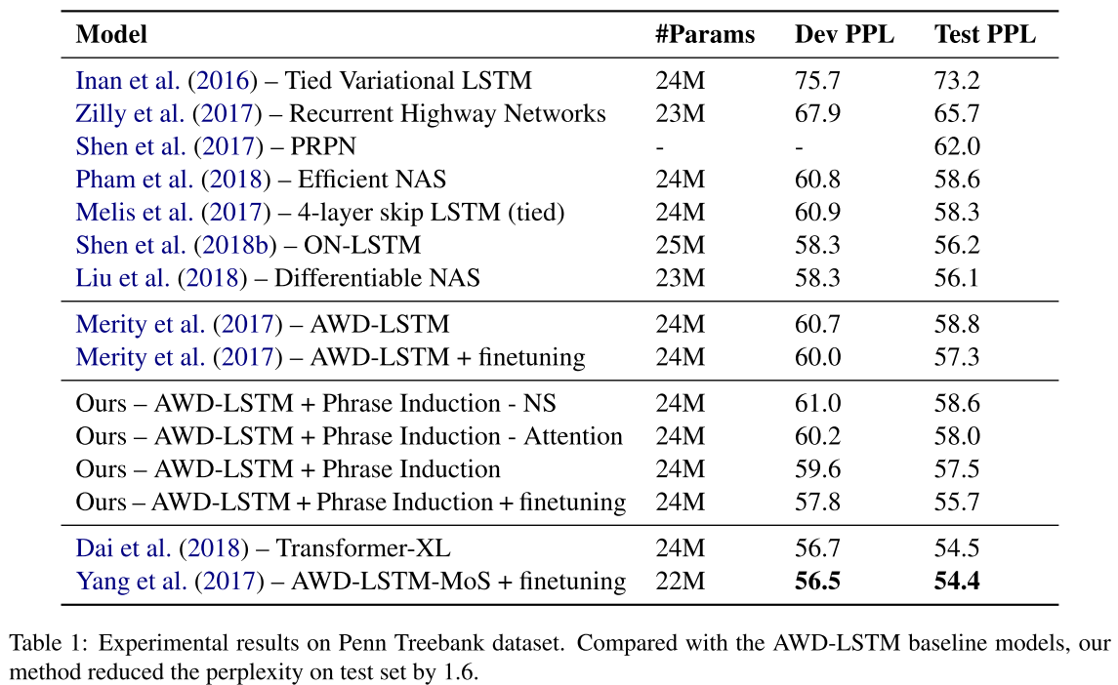
Experiments
Penn Treebank
the “finetuning” process stands for further training the language models with ASGD algorithm
Notes:
the “finetuning” process stands for further training the language models with ASGD algorithm
improved the AWD-LSTM, reducing 2.2 points of perplexity on the validation set and 1.6 points of perplexity on the test set
ablation study without either headword attention (averaging word vectors in the induced phrase) or negative sampling(only use the embedding of true induced phrases to align with the context embedding)

Slide 24
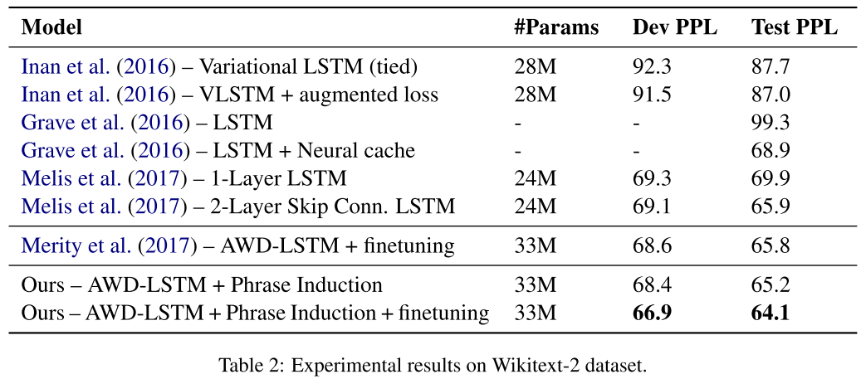
Experiments
Wikitext-2
3-layer AWD-LSTM language model
The network has the same input size, output size, and hidden size as the model we applied on PTB dataset.
Use a batch size of 60. The embedding dropout rate is 0.65 and the dropout rate of hidden outputs is set to 0.2
Notes:
improves the AWD-LSTM model by reducing 1.7 points of perplexity on both the validation and test sets

Slide 25
Experiments
Wikitext-103
The current state-of-the-art language model trained on Wikitext-103 dataset is the Transformer-XL
We apply our method on the state-of-the-art Transformer-XL Large model, which has 18 layers and 257M parameters.
The input size and hidden size are 1024. 16 attention heads are used. We regard the first 14 layers as the phrase generator and the last 4 layers as the word generator.
Because of the limitation of computational resources, we use our approach to fine-tune the officially released pre- trained Transformer-XL Large model for 1 epoch.

Slide 26
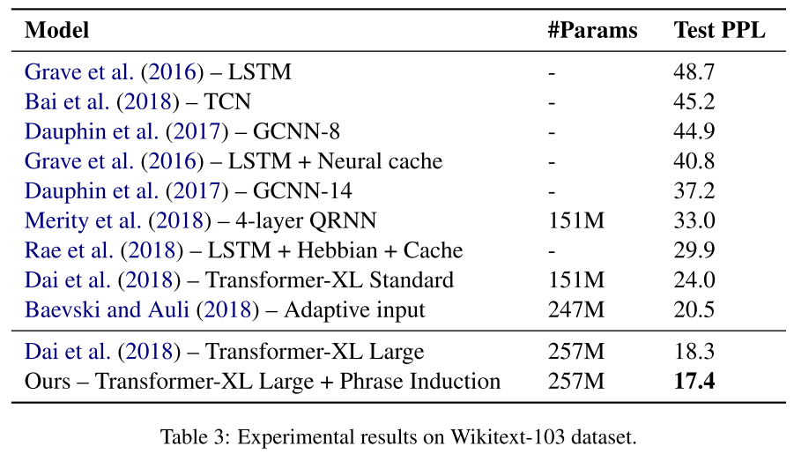
Experiments
Wikitext-103

Slide 27
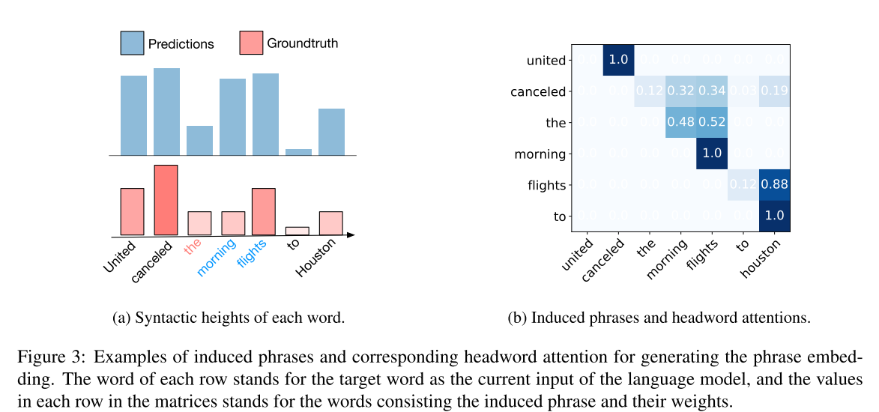
Discussion
What is learned by training language models with the context-phrase alignment objective function.
Notes:
Attention weight

Slide 28
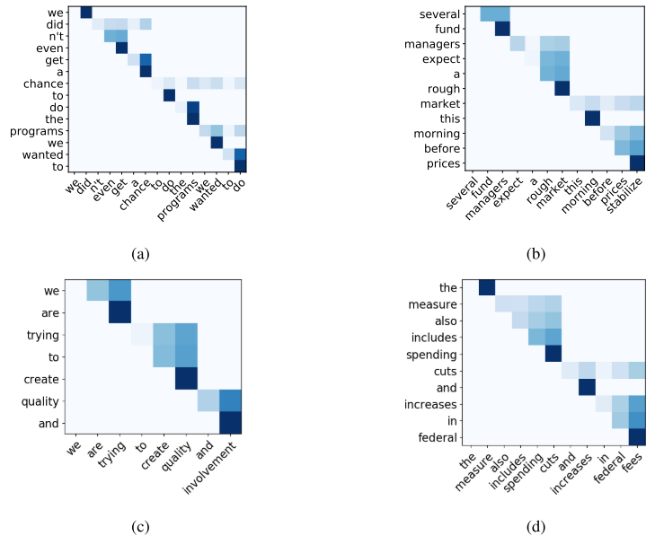
Discussion
What is learned by training language models with the context-phrase alignment objective function.
Notes:
random examples without any UNK words

Slide 29
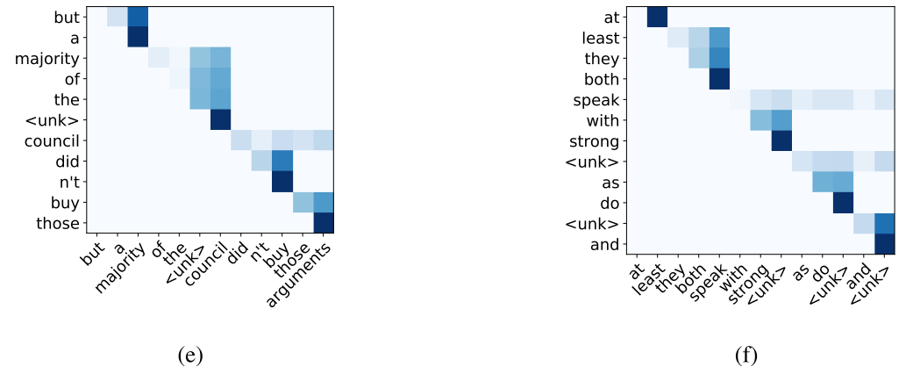
Discussion
What is learned by training language models with the context-phrase alignment objective function.
the <unk> council
with strong <unk>

Slide 30
Conclusion
Improved state-of-the-art language models by aligning context and induced phrases
Defined syntactic heights and phrase segmentation rules
Successfully learned approximate phrase-level knowledge, including segmentation and headwords, without any annotation.

Slide 31
Improving Neural Language Models by Segmenting, Attending, and Predicting the Future
Thanks !

